Slide 1


SQL PROJECT ON
MUSIC STORE MANAGEMENT SYSTEM
Presented By:
Priya Dakhore
Akurala Harshitha

Slide 2

OBJECTIVE
This project aims to explore and analyze the Music Store Database using SQL to uncover key business insights and trends. The primary objectives are:
Employee Analysis
Geographic Insights
Product Portfolio Insights
Music & Genre Performance
Regional Genre Preferences

Slide 3
PROBLEM STATEMENT
The music store generates large volumes of data across sales, customers, employees, and inventory.
This data is not systematically analyzed, limiting actionable insights for decision-making.
The absence of structured analysis hinders the identification of top products, genres, and customer trends.
There is a need to transform raw data into clear, data-driven insights to support strategic planning.

Slide 4
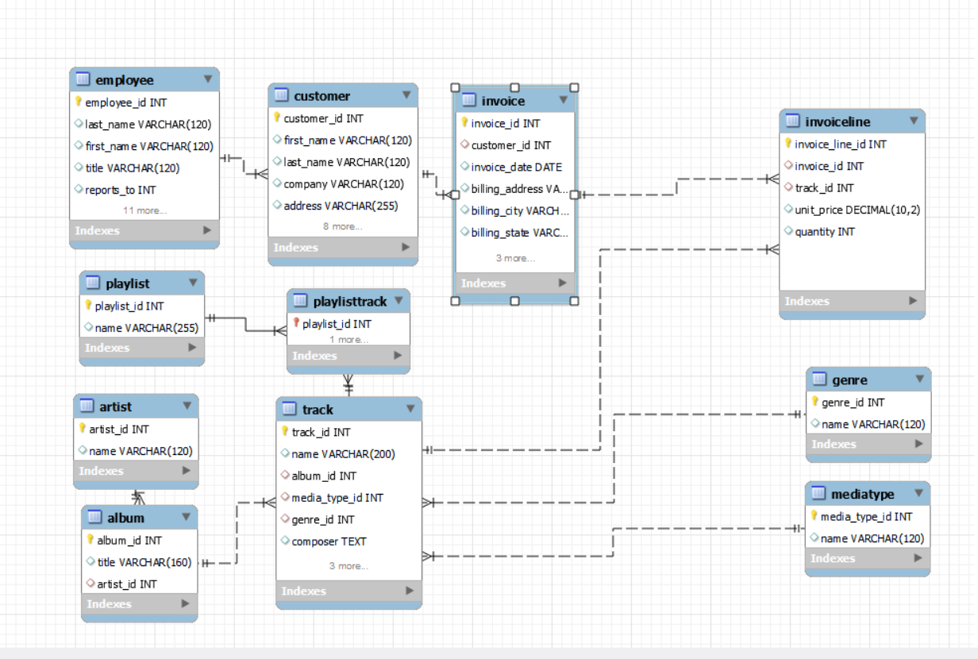
ER DIAGRAM

Slide 5
UNDERSTANDING THE SCHEMA
The database is designed in 3rd Normal Form (3NF) to ensure minimal redundancy and efficient querying.
Core Entities include:
Customer - Stores customer details and contact information.
Invoice - Record sales transactions.
InvoiceLine - Individual purchased items.
Artist,Album,Track – Define the music catalog.
Genre & MediaType – Classify tracks by style and format.
Employee – Maintains staff information and reporting hierarchy.
Primary Keys (PKs) uniquely identify each record, and Foreign Keys (FKs) enforce relationships between tables.

Slide 6
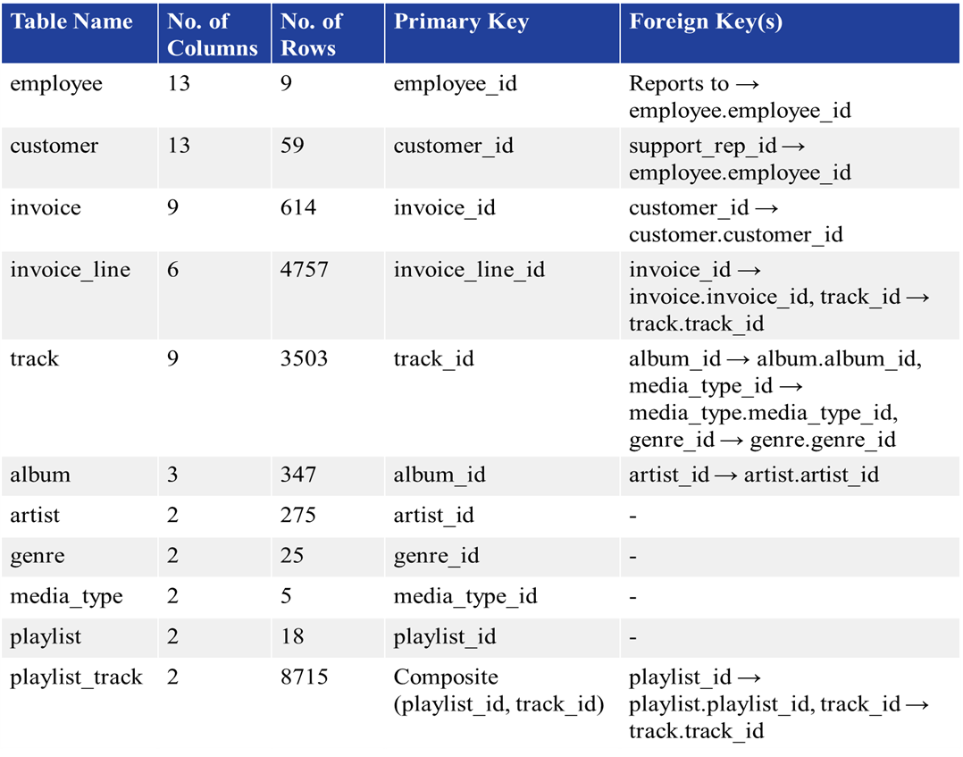
SCHEMA STRUCTURE

Slide 7
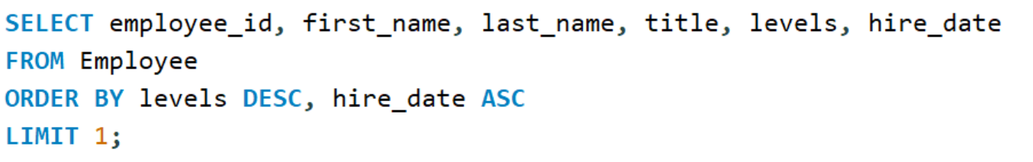

1. Who is the senior most employee based on job title?

Slide 8
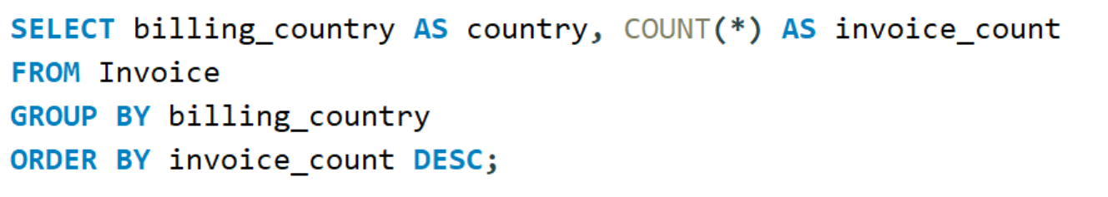
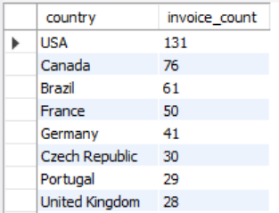
2. Which countries have the most Invoices?

Slide 9
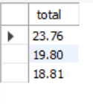
3. What are the top 3 values of total invoice?

Slide 10
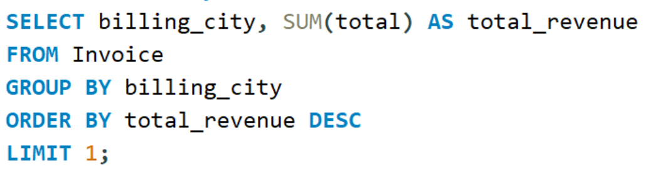

4. Which city has the best customers? - We would like to throw a promotional Music Festival in the city we made the most money. Write a query that returns one city that has the highest sum of invoice totals. Return both the city name & sum of all invoice totals.

Slide 11
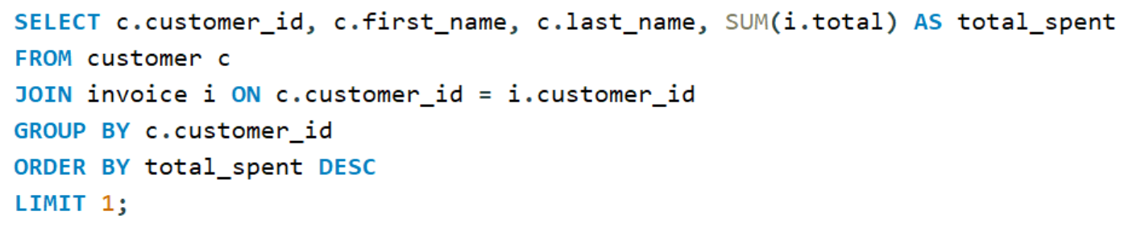

5. Who is the best customer? - The customer who has spent the
most money will be declared the best customer. Write a query
that returns the person who has spent the most money.

Slide 12
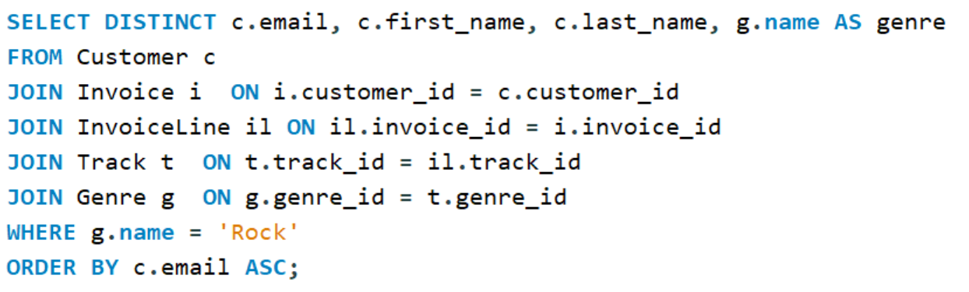
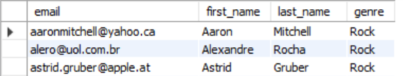
6. Write a query to return the email, first name, last name, & Genre of all Rock Music listeners. Return your list ordered alphabetically by email starting with A.

Slide 13
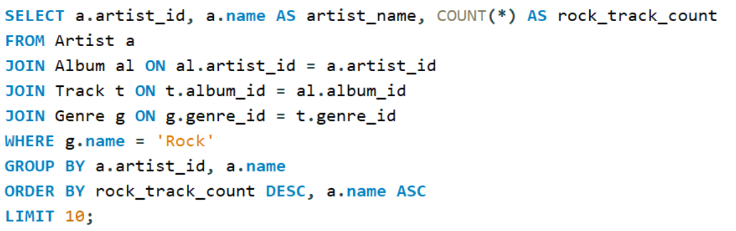
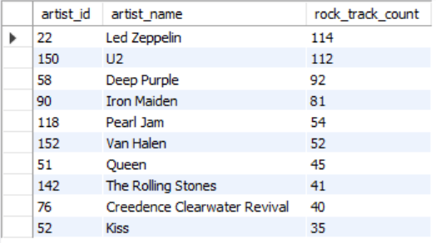
7. Let's invite the artists who have written the most rock music in our dataset. Write a query that returns the Artist name and total track count of the top 10 rock bands .

Slide 14
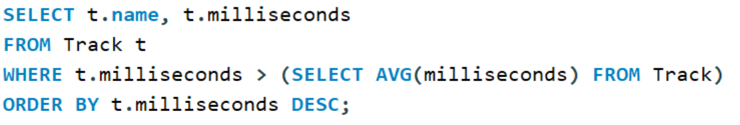
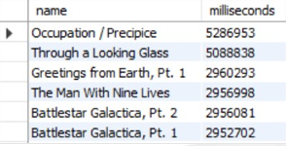
8. Return all the track names that have a song length longer than the average song length.- Return the Name and Milliseconds for each track. Order by the song length, with the longest songs listed first

Slide 15
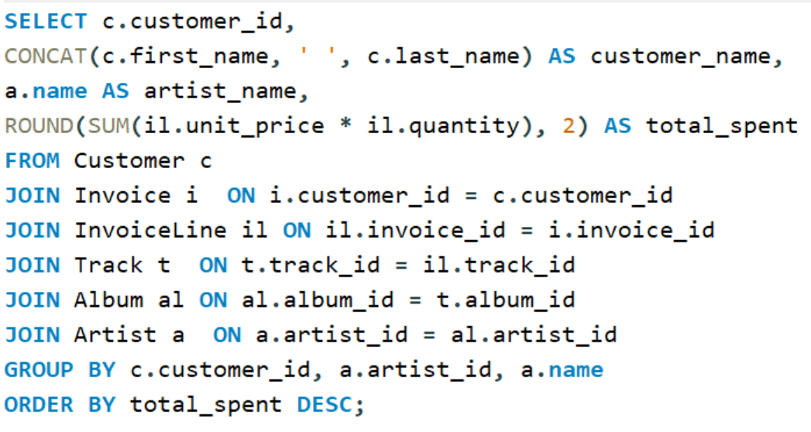
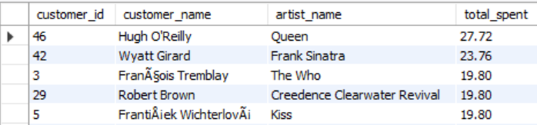
9. Find how much amount is spent by each customer on artists? Write a query to return customer name, artist name and total spent

Slide 16
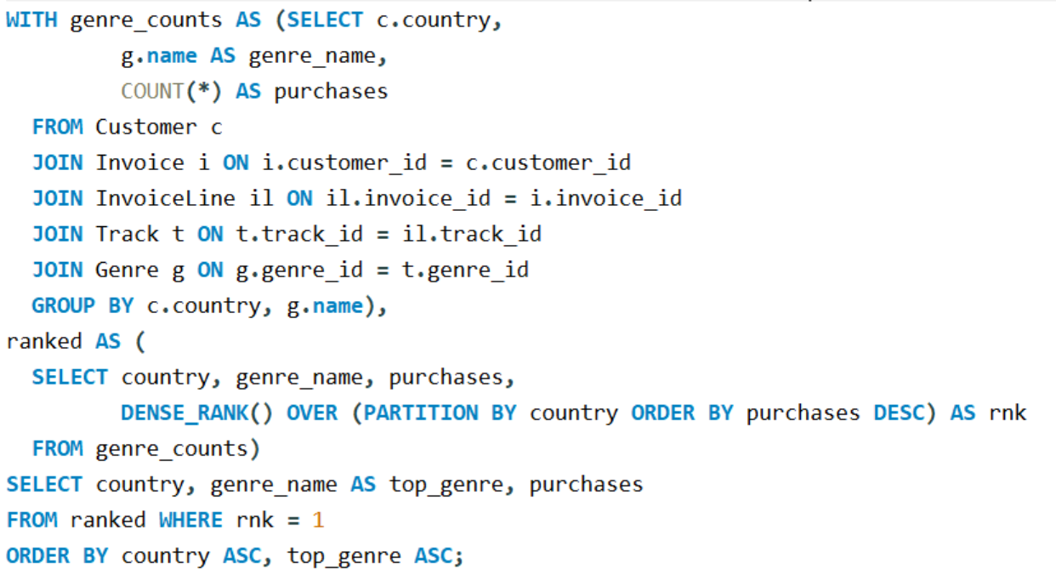
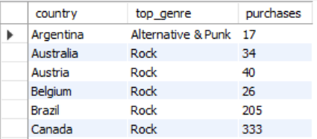
10. We want to find out the most popular music Genre for each country. We determine the most popular genre as the genre with
the highest amount of purchases. Write a query that returns each country along with the top Genre. For countries where the maximum number of purchases is shared, return all Genres

Slide 17
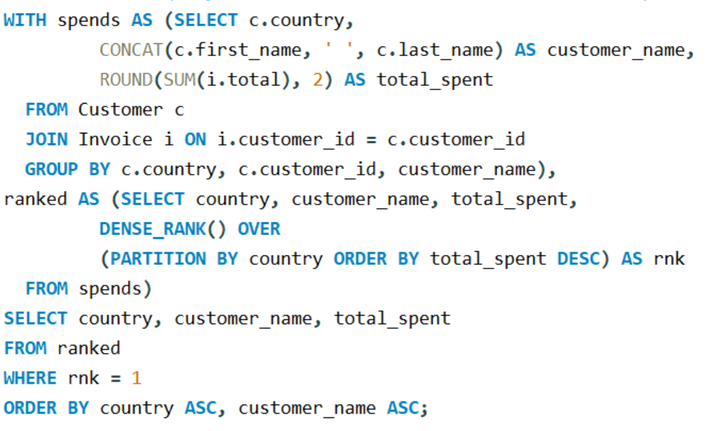
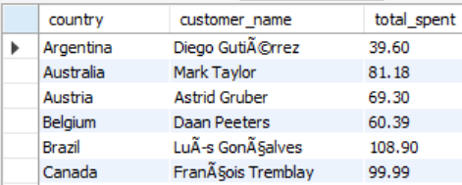
11. Write a query that determines the customer that has spent the most on music for each country. Write a query that returns the country along with the top customer and how much they spent. For countries where the top amount spent is shared, provide all customers who spent this amount

Slide 18
CHALLENGES
Managing complex joins across multiple related tables.
Handling large datasets while maintaining query efficiency.
Ensuring accuracy and consistency of aggregated results.
Structuring nested queries and CTEs for advanced analysis.
Translating raw query outputs into clear business insights.

Slide 19
CONCLUSION
Through systematic SQL analysis, the project uncovered key patterns in customer behavior, sales performance, and music preferences across regions. The results highlight top-performing markets, valuable customer segments, and popular genres, providing actionable insights for targeted promotions and strategic growth. This approach demonstrates how well-structured queries can convert raw data into meaningful intelligence for decision-making.

Slide 20
THANK YOU

